Slide 1
Solve a Problem with a Problem:
Problem-Based
Learning
Sandra Bowling, P.E.
Program Chair Built Environment Professor of Drafting and Design

Slide 2
Introductions
Name
Discipline
Do you like to be in the city or the country? Why?

Slide 3
Class Outcomes
Agenda
Introductions
Overview
A Problem to Solve
Definition of Problem Based Learning
It’s Your Turn
Participants will be able to:
Define problem based learning
Apply problem based learning to their teaching practice

Slide 4
Sage Advice About Education. . .
Tell me and I forget, teach me and I may remember, involve me and I learn – Benjamin Franklin
In learning you will teach, and in teaching you will learn – Phil Collins
You will never learn as much as when you are teaching – Author Unknown
I am always ready to learn although I do not always like being taught –
Winston Churchill
Education is not the learning of facts, but the training of the mind to think –
Albert Einstein

Slide 5
Overview of Problem Based Learning (PBL)
What is PBL?
Problem-based learning is an instructional method in which students are presented with an open-ended problem to investigate and resolve. The problem drives the learning.
Students generally must:
Define the problem
Explore what is already known
Determine what needs to be learned and how to access the information
Gather and share information
Generate and evaluate possible solutions
Present and support one chosen solution
Students are provided:
Problem statement
Questions to consider in their responses to the problem
Guide to the problem that clarifies the instructor’s expectations on work submitted
Notes:
Problem-based learning (PBL) is an approach that challenges students to learn through engagement in a real problem. It is a format that simultaneously develops both problem solving strategies and disciplinary knowledge bases and skills by placing students in the active role of problem-solvers confronted with real life problems that simulates the kind of problems they are likely to face in their future.

Slide 6
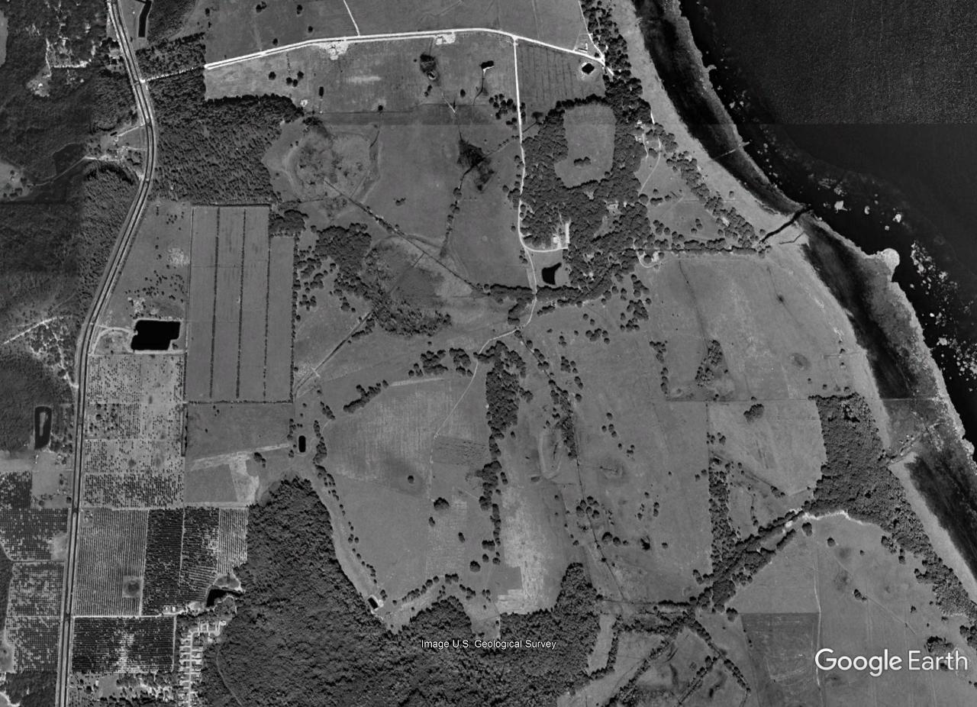
PROBLEM BASED LEARNING
SUBDIVISION DESIGN

Slide 7
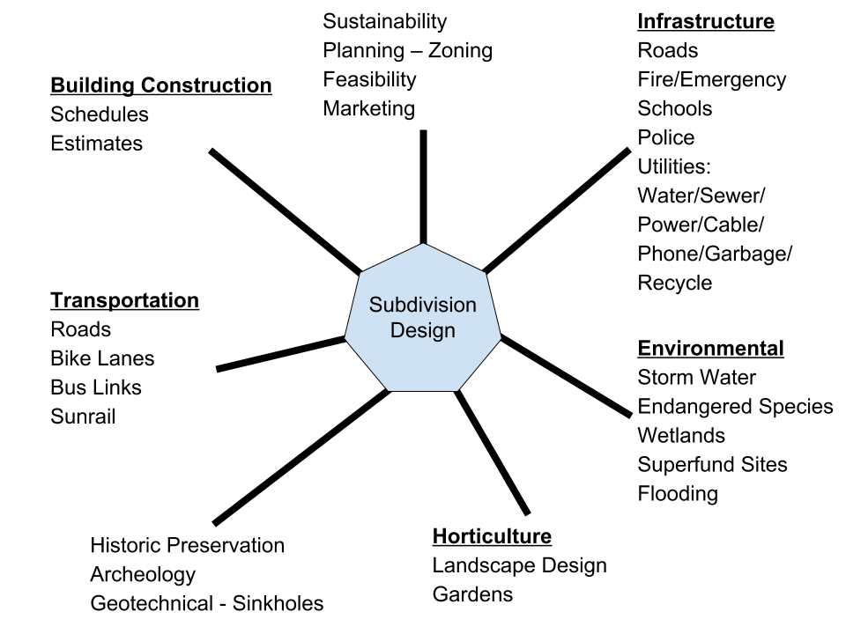
Group Scenarios
BRAINSTORMING Scenarios
What resources do you expect in your neighborhood?
How would you develop this land?
Who would you need to partner with during this development?
What would some challenges be?
Developer
Engineer/Surveyor
Environmentalist
Community
Governmental Agencies

Slide 8
Definition of Problem Based Learning
Problem-based learning is both a teaching method and an approach to the curriculum that addresses complex real-world problems.
These carefully designed problems challenge students to use problem solving techniques, self-directed learning strategies, team participation skills, and disciplinary knowledge.
Notes:
Combination of definitions by the University of Illinois and University of Michigan
Problem-Based Learning is a teaching method in which complex real-world problems are used as the vehicle to promote student learning of concepts and principles as opposed to direct presentation of facts and concepts.
-University of Illinois
http://citl.illinois.edu/citl-101/teaching-learning/resources/teaching-strategies/problem-based-learning-(pbl)
Problem-based learning (PBL) is both a teaching method and an approach to the curriculum. It consists of carefully designed problems that challenge students to use problem solving techniques, self-directed learning strategies, team participation skills, and disciplinary knowledge.
-University of Michigan
http://www.crlt.umich.edu/tstrategies/tscbt

Slide 9
Activity
Review examples of PBL

Slide 10
Problem-Based Learning: Experience It Yourself Deflating Grady

Slide 11
Grade inflation
Grade inflation poses a problem on many campuses and is an issue familiar to faculty regardless of their discipline. This six-stage problem for a faculty development workshop, introduces faculty to PBL and employs a variety of pedagogical strategies. Grady Rizeng, a chaired professor, upset by being confronted by his chair, Lois Marks, about the high grades he gave, forwards the accusations and complains to Dean Nolira in a late-night e-mail message.
That e-mail exchange serves as trigger in Stage 1 to explore the meaning, causes, and implications surrounding grade inflation with the eventual goal in Stage 6 of proposing reasonable ways to deal with the situation. The problem employs written, oral, and visual communication; involves Internet research elements; and addresses mathematical literacy.

Slide 12
Deflating Grady – Part 1 : Maintaining Standards
Read over the e-mail exchange and discuss the ideas it raises about grade inflation.
As a group, compose a definition of grade inflation and be prepared to present it.
Be prepared to “report out” in 5 minutes.

Slide 13
Deflating Grady – Part 2 : Midnight Thoughts
Read over the information presented, and be prepared to report out on your answers to either question 1 or question 2.
Be prepared to “report out” in 15 minutes

Slide 14
Deflating Grady – Part 3 : What’s the Evidence
Take a look at the graph from gradeinflation.com:
According to your group’s definition, is this evidence for grade inflation?
Make a list of questions (learning issues) you have about these data.
Be prepared to “report out” in 15 min.

Slide 15
Deflating Grady – Part 4: Who Cares
Who cares about grade inflation? Match the stakeholders with their comment.
Each person in your group select a different stakeholder and wait for instructions.
1. | Chairman Marks |  | A. | "This is a complex problem. We need to create a culture where learning not grades is the focus."
2. | Dean Nolira |  | B | "This is an academic freedom issue. They can't tell Grady what to do."
3. | Student Newspaper Reporter |  | C. | "In addition to grades, the transcript should include a score from a nationally standardized exam in the discipline."
4. | Faculty Union Representative |  | D. | "Why is Prof. Rizeng being harassed by his department when he's a great teacher?"
5. | Parent of a Student |  | E. | "What are Joe's chances of getting into medical school if they limit the number of "A's"?
6. | Alumnus who hires Graduates |  | F. | "Without uniform and demanding standards, grades aren't worth a thing."

Slide 16
Deflating Grady – Part 5: What’s our Position
In stakeholder groups, please discuss the Princeton model for addressing grade inflation. Propose an improved model.
The following questions are offered to help your stakeholder group focus its attention and define its position on grade inflation.
What are the symptoms of grade inflation?
How is grade inflation manifested?
Does grade inflation hurt your stakeholder group, and if so, how?
Under what conditions does grade inflation hurt your stakeholder group?
How big is the problem?
Is it getting worse?
What are the implications of the problem?

Slide 17
Deflating Grady – Part 6: Formulating a Position
Return to home groups and please share and discuss the results of your stakeholder discussion. Propose an improved consensus model that reflects input from all perspectives.
Princeton University's faculty recently approved a proposal to limit the number of "A's" in any department to 35%. Your diverse group of stakeholders has been charged by the ITUE leaders to do better and come up with an effective solution. Your plan needs to eliminate or reduce the problem of grade inflation and be feasible in terms of time, person-power, expense, and material. The interests of multiple stakeholders must be considered.
Your satisfactory plan will be presented to the assembled audience tomorrow. You are limited to five minutes and four PowerPoint slides. A structured argument with data will strengthen your proposal, which will be peer-evaluated.
.

Slide 18
What Just Happened?
Content Knowledge about Problem-Based Learning
Ill-Structured Problem triggers interest, stimulates critical thinking, promotes self-directed learning and ownership, stimulates elaboration and promotes teamwork
Reasoning or critical thinking about complex concepts in terms of comprehension, analysis, evaluation
Communication with group members
Assessment and Reflection
Notes:
Problem-based learning is student-centered. PBL makes a fundamental shift--from a focus on teaching to a focus on learning. The process is aimed at using the power of authentic problem solving to engage students and enhance their learning and motivation.
There are several unique aspects that define the PBL approach: The PBL approach is grounded in solid academic research on learning and on the best practices that promote it. This approach stimulates students to take responsibility for their own learning, since there are few lectures, no structured sequence of assigned readings, and so on.
PBL is unique in that it fosters collaboration among students, stresses the development of problem solving skills within the context of professional practice, promotes effective reasoning and self-directed learning, and is aimed at increasing motivation for life-long learning.
As teacher, my role changes from "sage on stage" to a "guide by the side." My role is more like that of a facilitator and coach of student learning, acting at times as a resource person, rather than as knowledge-holder and disseminator
The student role, is more active, as they are engaged as problem-solvers, decision-makesr, and meaning-makers, rather than being merely passive listener and note-taker.

Slide 19
PROBLEM BASED IDEATION PHASE
Brainstorm: (1) What are a few problems that individuals in your discipline typically address? (2) Star the one you want to move forward in developing that aligns with your course outcomes. | Knowledge & Skill Breakdown: In order for your students to be able to engage with the problem what knowledge and skills do they need to have? What will you need to do to prepare your students?
Real World Connection: How do people encounter this problem outside of a classroom? | Tasks: How do people engage in this work? What types of format does this content usually take in terms of process, design, or discourse?
Roles: Who are the people involved in this problem? Who should students address in terms of process? | Complexity and Critical Thinking: How are you ensuring there is a challenge and application of critical thinking to this problem?
What would success in “solving” this problem look like? | Other organizing thoughts or elements to this problem to keep in mind:

Slide 20
Drafting Your Problem Based Scenario
Use the outline below to begin to plan and for how you will enact your problem based learning scenario in your class. Once you have completed this take a moment to check for the authenticity, relevance, and complexity of the scenario.
Course Outcomes: | Length of Time for Activity:
Problem Statement/Prompt:
Materials Needed/Provided:
How will students do the work? (Groups, Specific Strategies, Platforms, Roles, ect.)
What is/are the final product(s) that students will need to be developed?
How will you assess this problem? Think about specific criteria you will use.

Slide 21
Benefits of PBL for students
Heightened emphasis on value of prior knowledge
Easy to see how learning applies to real issues outside the classroom
Can teach interdepartmental collaboration skills
Learning is self-directed
Opportunities for reflection
Teaches research as timely acquisition of knowledge
Process itself is one they can draw on to face challenges
Notes:
Traditional education practices, starting from kindergarten through college, tend to produce students who are often disenchanted and bored with their education. They are faced with a vast amount of information to memorize, much of which seems irrelevant to the world as it exists outside of school. Students often forget much of what they learned, and that which they remember cannot often be applied to the problems and tasks they later face in the business world. Traditional classrooms also do not prepare students to work with others in collaborative team situations.
The result: students tend to view education as simply a "rite of passage," a necessary "union card," and an imposed set of hurdles with little relevance to the real world. Education is reduced to acquiring a diploma (merely another commodity to be purchased in the marketplace), and the final grade becomes the overriding concern (rather than learning).
Perhaps one of the greatest advantages of PBL is that students genuinely enjoy the process of learning. PBL is a challenging program which makes studying intriguing for students because they are motivated to learn by a need to understand and solve real clinical problems. The relevance of information learned is readily apparent; students become aware of a need for knowledge as they work to resolve the problems.

Slide 22
Proposed Structure
Week | Activity
1-4 | Material covers so students have a basis for their knowledge inventory (list of “what is known” and “what is needed”)
5 | In small groups, students come to a mutual understanding of the problem and explore existing knowledge. Information may come from the problem itself and from the prior experiences of group members. Students should identify what new information they need to learn.
6 | In small groups, students gather and share their research
7 | In small groups, students use what they have learned to generate and evaluate possible solutions to the problem. Students select one solution and prepare materials to present and support it.
8 | All students review the solutions of each small group. Large group debrief through Adobe Connect or similar
Assessments
Week 5—group summary of known and needed knowledge plus research plan
Week 6—posts of individual students regarding research
Week 7—group problem solution (paper and/or presentation)
Week 8—individual papers - overall assessment and reflection

Slide 23
Tips for Implementation
Make sure your problem is open-ended/ill-structured, but also offers appropriate constraints
Consider whether an existing assessment (like an end of class essay) could be turned into a problem
Assess products from the group, not individual discussion board posts
Require regular submission of self and group assessments from each student
Provide tips for working in groups in your resources area
PBL does not have to involve group work, and the learning experience can last for any duration

Slide 24
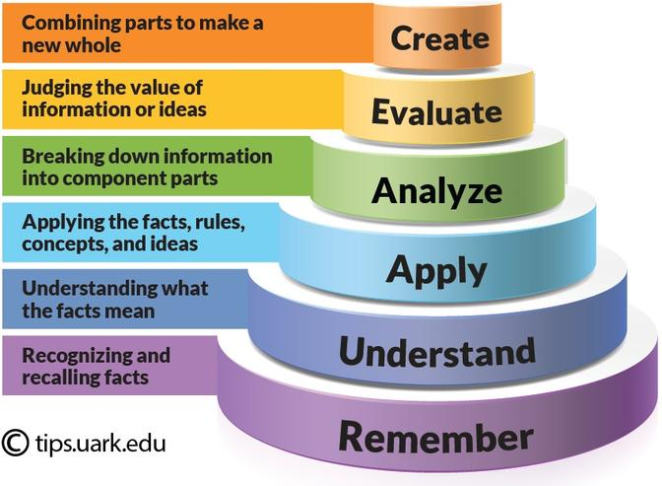
Critical Thinking/Cognitive Complexity: Bloom’s Taxonomy
Notes:
Bloom’s taxonomy is one way to think about cognitive complexity. Why is thinking more interesting than memorizing?

Slide 25
Steps in how to implement PBL in your courses:
Needs Assessment –
Identify the content, skills or concept you plan to cover presentation of an ill-structured problem
Writing a problem statement
Specify the unit of time you will cover the topic –
1 week – 3 weeks… semester
Think Application –
When would someone use this knowledge in the real world?
Knowledge inventory (list of “what is known” and “what is needed”)
Formulation of learning issues
Think Authenticity and Relevance -
Students want to know why they have to learn something… Buy In
Think is there one solution or can there be many solutions?
Think Product –
How will students present their findings and solutions - Assessment

Slide 26
Challenges in using PBL
Creating the Problem /Project
Developing guiding questions
Time management of Students
Cooperative and Collaborative Group dynamics
Assessment of problem or project

Slide 27
To Sum. . .
Design an authentic problem that reflects the complexity of discipline
Give learners ownership of the process Support and challenge learners' thinking.
Encourage alternative views and contexts.
Provide opportunity for reflection on both the content learned and the learning process.

Slide 28
Looking Ahead to the Capstone
If you plan on completing the Active Learning Certificate, you will want to save:
Project-based Learning Activity lesson plan
Student work after implementation of activity in one of your courses
Student feedback after implementation of activity
Self reflection after implementation of activity

Slide 29
Resources
Cornell University Center for Teaching Excellence: https://www.cte.cornell.edu/teaching-ideas/engaging-students/problem-based-learning.html
Problem-Based Learning at University of Delaware: http://www1.udel.edu/inst/index.html
University of Queensland Institute for Teaching and Learning Innovation: http://www.uq.edu.au/teach/flipped-classroom/problem-bl.html

Slide 30
Examples of Possible Products - Assessment Group / Individual – Formative (CATs)/Summative

Slide 31
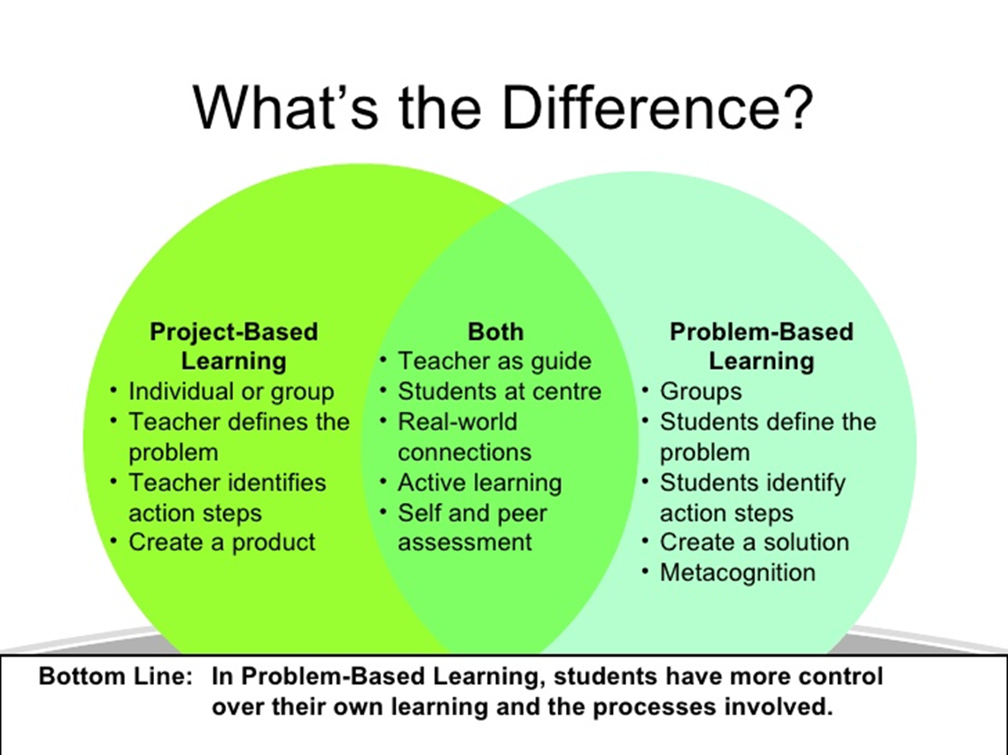
Project vs Problem

Slide 32
Solutions to some to the challenges…
Articulate the learning outcomes of the project. What do you want students to know or be able to do as a result of participating in the assignment?
Create the problem. Ideally, this will be a real-world situation that resembles something students may encounter in their future careers or lives. Cases are often the basis of PBL activities.
Establish ground rules at the beginning to prepare students to work effectively in groups.
Introduce students to group processes and do some warm up exercises to allow them to practice assessing both their own work and that of their peers.
Consider having students take on different roles or divide up the work up amongst themselves. Alternatively, the project might require students to assume various perspectives, such as those of government officials, local business owners, etc.
Establish how you will evaluate and assess the assignment. Consider making the assessments students make of their own work and that of their peers part of the assignment grade.

Slide 33
Problem to Solve
If discussion boards are supposed to recreate this environment online,
What is going wrong?
Enforced initial response to a particular question posed by the instructor
Peer responses are often based on economy, not interest in the topic
Rules
More rules
Confused by rules? Here’s a rubric!
then they are not working!

